Slide 1
Express Medical
Payroll Management System
The Brogrammers:
Nicholas Borghese,
Vincent Ippolito,
Carl Mendez,
Ilya Shvabskiy,
Nick Wilson

Slide 2
Front End
Documentation
Nick Borghese
Ilya Shvabskiy
Carl Mendez
Back End
Vincent Ippolito
Nick Wilson

Slide 3

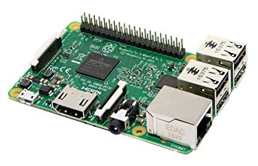
Server running on a raspberry pi
Cost: $35

Slide 4
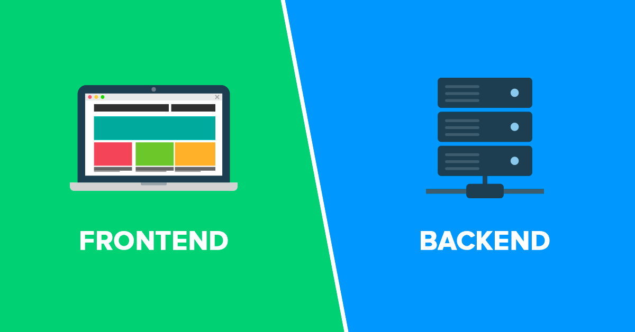

Communication
HTML
CSS
JS
SQL
PHP
Discord

Slide 5
What can our product do?
Give employers and employees payroll stubs
Show employees their:
Information
Benefits
Taxes
Add, edit, and delete employees
Contact other employees
Easy access to all employee contacts

Slide 6
Why should you use our product over others?
Simple design
Easy to use
Good functionality
Convenience

Slide 7
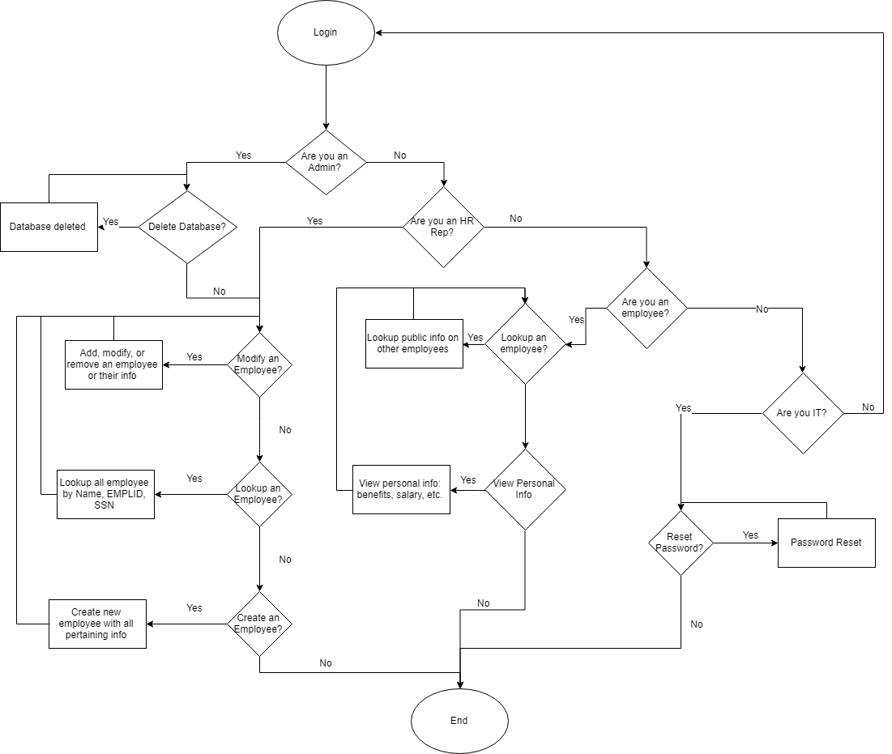
Original UML

Slide 8
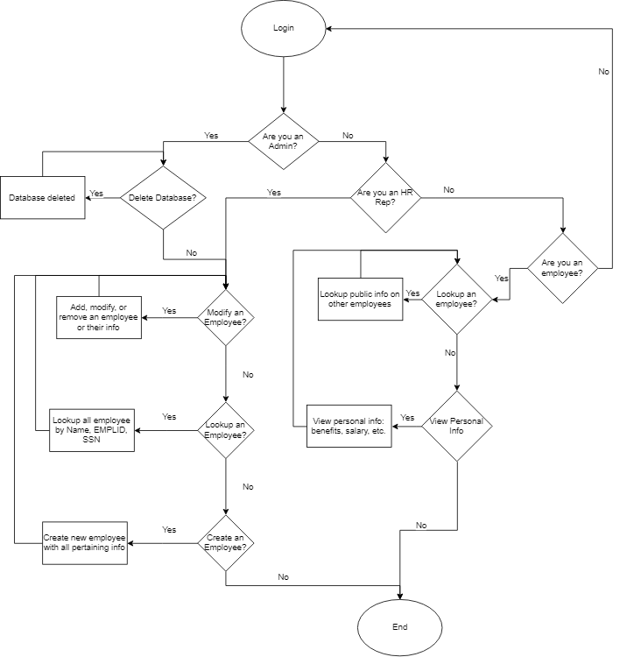
Changed UML

Slide 9
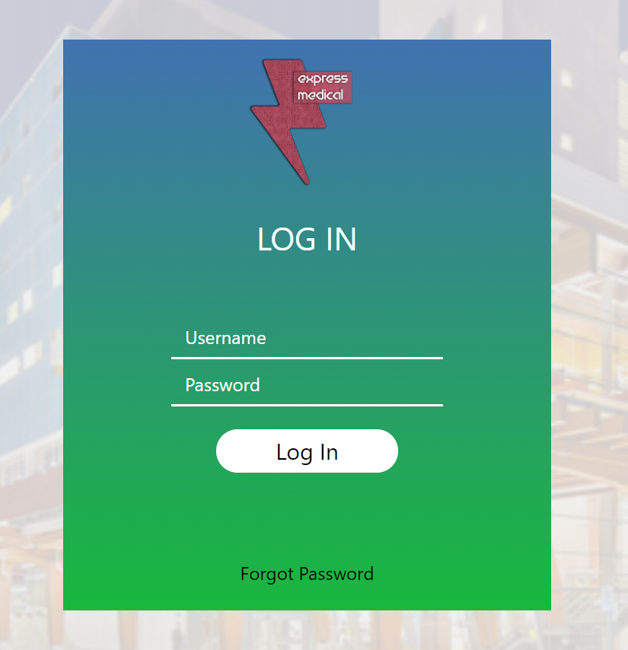
Demo

Slide 10
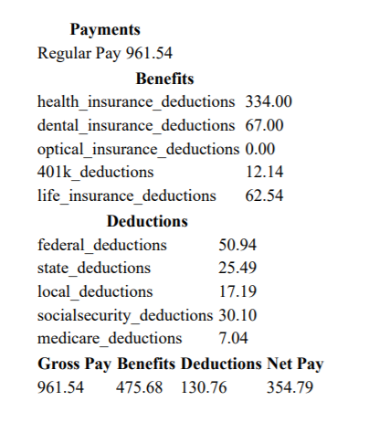
Employee Pay Stub

Slide 11
Modifications since previous demo
My benefits and my info pages combined on Admin and HR accounts
My finances page redesign
Ability to print paystub
Admins have the ability to add/edit gross pay for employees
Admins and HR have the ability to edit employee benefits

Slide 12
Lessons Learned
Breaking up project in the beginning is easier said than done
Plan ahead
Don’t elect a person to be group leader when they don’t want to be because they know they’re unqualified
Plan for many errors
Manage time
Don’t take other classes at the same time

